Slide 1
Digital Security for Ombuds

Slide 2
Digital Security for Ombuds
Challenge:
The introduction of digital tools into ombuds creates risks around unauthorized data access and system compromise.
Different Types of Risks:
Internet security: risk by the interconnection to the public network;
System security: risk of malfunction or improper operation of digital system;
Algorithm security: risk of algorithm ethical principles;
Operator security: risk of operator qualifications or dishonesty;
Trust security: risk of credible data communication to other digital systems.

Slide 3
What types of tools are ombuds using?
Email
Calendar invitations
Word documents
Skype calls
Google docs
Text messages
Social media platforms
These tools all have security concerns

Slide 4
Email security
Emails travel across multiple networks and servers before arriving in their intended audience’s inbox.
Emails aren't encrypted
Servers hold emails that are decades old, even after they're deleted
Once your password is compromised, all emails are accessible
Emails touch multiple devices (e.g. laptop, mobile, watch) each of which can be compromised
The sender cannot prevent recipients from further forwards

Slide 5
Secure text-based communication
Email/SMS notifications should never contain substantive communications
All substantive communications should be on a password-protected ODR platform
Require two factor authentication, or complex passwords, for platform access
Don’t email attachments – share documents in a password-protected file repository

Slide 6
Videoconferencing security risks
Who has access?
Zoom bombing
Are all participants visible?
Other people in the room, off camera
What is being recorded?
Can the session be secretly recorded?
Phone on record next to the speaker
Can someone intercept the video feed?
Who can control your local machine?
Is location tracked by the application?

Slide 7
Videoconferencing Security Steps
Use a secure videoconferencing platform with end-to-end encryption
Do not use apps or software that require location information to be shared, or inform the parties that they have the ability to turn that off (and explain how to do so)
Use waiting rooms, passcodes, and room locking to prevent unauthorized access
Don’t record your sessions

Slide 8
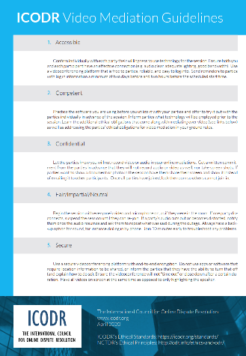
Odr security guidelines
ICODR is working on ODR Security Guidelines
https://icodr.org
Notes:
Court disputes (low value civil cases: e.g. divorce, tenant)
Public disputes (e.g. Property Tax Appeals)
Insurance (e.g. AAA NYNF Process)
Product liability (e.g. Pharmaceuticals)
Consumer (e.g. Ombuds offices, UK CAA)
eCommerce disputes (payments, marketplaces, merchants)

Slide 9
Security Best Practices
Require training for ombudspeople in data security
Don’t use open platforms for ombuds – use systems that are purpose-built for ombuds
Only use ombuds platforms that have been security certified (ISO 27001/SOC 2)
Require routine security audits and penetration tests for ombuds platforms

Slide 10
Security Questions
What obligations do ombuds have around security?
What obligations do ombuds platform providers have around security?
What are the top five things ombuds can do to make their online work more secure?
Can a ombudsperson be held liable for poor information security practices?
Can an outcome be challenged on the basis of IT security concerns?
What disclosure obligations do ombuds platform providers have in the event of a data breach?
Should there be sanctions for ombudspeople and ombuds platforms that don’t abide by industry standards around data security?
How can an individual know whether their ombudsperson is being responsible with their information?

Slide 11
Discussion

